Slide 1

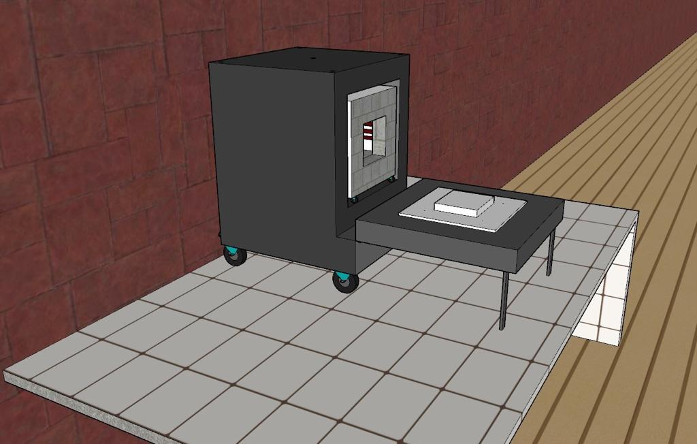
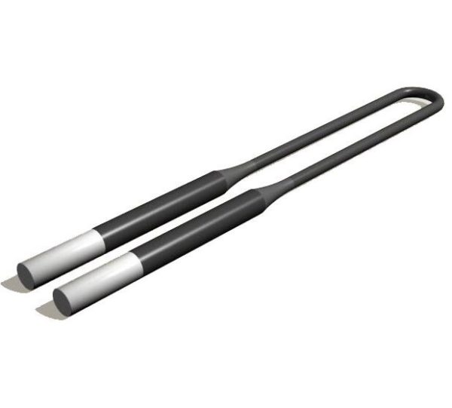
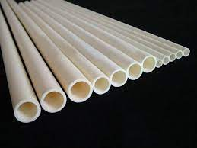
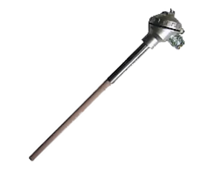
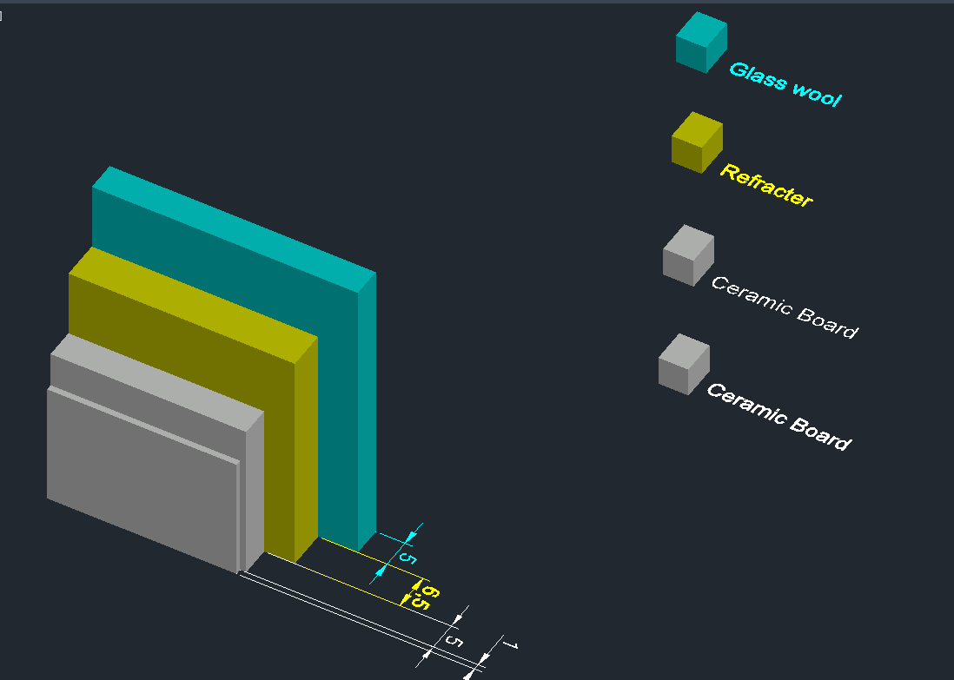
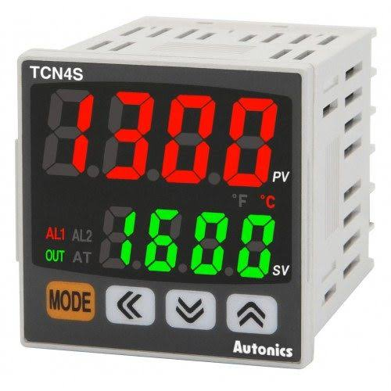
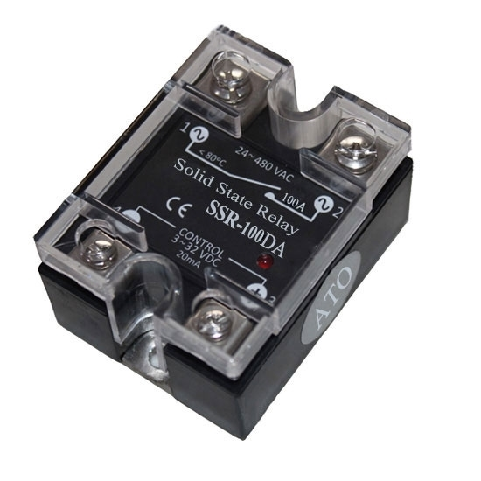
TUBOX
Ahmet Bekir SOLAK-Berkay HOPAL-Sıla İNAN-Mertcan Muhammet AYDIN
Merve Döker- Yunus Emre ALTAŞ-Evren KAĞAN-Oğulcan HAKSEVER-Çınar ÖNCEL
MME 4006 Application of Materials Processing and Design II
Muğla Sıtkı Koçman University, Faculty of Engineering, Department of Metallurgical and Materials Engineering
ABSTRACT
In this study, aim is combining two different types of high temperature laboratory furnaces into one compact furnace. Tube furnaces and box furnaces have different usage areas and have different abilities. Main idea of combining these different type of furnaces is combining of their properties and abilities. At the end of the combining these furnaces, get one compact furnace that have contain abilities of both.
MOTIVATION OF PROJECT
The general purpose of the project is to produce a furnace that can be used at any temperature up to 1600 C, which can be both a tube furnace and a chamber furnace at the same time. In this way, in addition to all the experiments that can be done in the chamber furnace, it is our goal to commercially produce and promote a new furnace where all the experiments that can be done with atmosphere control in the tube furnace can be done. In this way, an economical and space-saving product will be developed for users. When this goal is achieved, a new product that is unique in the market and that we have a patent will be produced.
OUTER CASE
HEATING ELEMENTS
Outer case of the furnace is another important designing parameter. Most important thing is outer case of the furnace, casing material must be protect the furnace from any damage and must be carry inner load. According to these needs, steel casing material is chose. In every material choosing stage, costs are considered.
A heating element provides convertion of electrical energy into heat through the process of Joule heating. Electric current through the element encounters resistance and this results in heating of the element. Differently from Peltier effect, this process is independent of the direction of current.
The right surface, bottom surface and left surface of the furnace are composed of one piece Top and back lids will be installed later. The back and top lid are designed to be opened easily in case of any problem in the furnace. The furnace consists of two main parts, upper and lower parts. The upper section meets the main function of the furnace. The lower section consists of the control panel and electrical accents. These two main parts can be easily removed because of the rail system
Since the furnace will operate temperatures up to 1600 °C, the heating element chosen should have the ability to operate at this temperatures as well. When the operating conditions and cost are considered the best available type of heating element is Molybdenum disilicide.
Alumina Tube
Thermocouple
For the tube furnace, high purity alumina tube is selected according to the operation temperature and thermal stability. The reason for usage of the tube is to provide the required atmosphere to the samples that need to be processed in a different atmosphere environment.
Thermocouples are preferred in this furnace because they are self-operating, have a wide temperature range and have a fast response time. Thermocouple is a temperature measuring device that is produced by welding two different metal ends or alloy.
Refractory Materials
R, S, B type thermocouples have platinum-rhodium wire and the outside of thermocouple is covered with ceramic material. The thermocouple to be used for this furnace has been designed with a 13 cm insertion depth and 10 cm tube length
A refractory material or refractory is a material that is resistant to decomposition by heat, pressure, or chemical attack, and retains strength and form at high temperatures
PID Control System
Ceramic board, chamotte brick and glass wool will be used as refractory materials. These materials were selected according to their refractoriness properties and the required thicknesses were calculated.
Temperature controllers are devices that control and regulate the temperature rising too high or falling below the desired. PID controller was used in this furnace. Because, it is the most accurate, stable and fastest reactive temperature contollers
Since the furnace will operate at 1600 °C , as the first layer a ceramic board resistant to 1600 °C then , as the next layer refractory brick resistant to 1350 °C, and as the last layer glass wool resistant to 250 °C are inwarded.
One of the purposes of refractory use is to minimize the heat loss of the furnace. Heat is transmitted by three ways: convection, conduction and radiation. With the refractory materials used , the heat loss caused by conduction and convection can be reduced , but another material is needed to prevent heat loss caused by radiation. Aluminum foil is ideal for this application as it is durable at 600 °C and has reflectivity higher than %90 along with being cheap.Since it is durable 600 C it should be placed between refractory brick and glass wool.
Solid State Relay
Relay is a circuit element used in the task of switching high current drawing devices by using low currents and relay is connected to PID controller and phases.A solid state relay was preferred to be used in this furnace .Because, since this furnace will operate at high temperatures, high voltage is required and solid state relays do not have any mechanical parts, so their life is longer than standard relays
Conclusion
In conclusion, both box furnace and tube furnace have different abilities and usage areas. In this study, both box furnace and tube furnace investigated seperately and instead of using both furnaces seperately for different purposes, combination of the box and tube furnaces into one compact furnace can provide all the features of the box and tube furnace. Also at the end of the study, because of the compact furnace can be used as both tube and box furnace, there is no need to buy both box furnace and tube furnace seperately. That means cost and occupied area for the furnaces can be saved.

